Slide 1
Narcan Administration

Slide 2
Objectives
By the end of this course the participants will learn about intranasal naloxone and will be able to:
  Recognize the signs and symptoms of an overdose
  Identify how to use intranasal Naloxone
  Identify the possible responses to intranasal Naloxone
  Be able to prepare and administer intranasal Naloxone
  Describe how continued support should be provided to the overdose victim
Notes:
This presentation is going to discuss the BLS use of Intranasal naloxone. Naloxone is the generic name while Narcan is the trade name.

Slide 3
Signs of an opioid overdose include:
Not waking up or responding to your voice or touch
Breathing that is very slow, irregular or has stopped
The dark center part of the eyes become very small (pinpoint pupils)
Fingernails and lips turn blue or purple
A slow heartbeat, weak pulse or low blood pressure

Slide 4
When is intranasal Naloxone used?
Bystanders should have contacted EMS (Dial 911) or sent for help
Use of intranasal Naloxone is for when the person is not responsive.
Intranasal Naloxone removes opiate effects and can reduce the duration of low oxygen in the blood, preventing injury or death.
Prolonged reduced breathing can result in injury to the brain.
While the person is not responsive, lung injury related to having stomach contents get into the lungs can occur and this can also cause death.
Reversing the overdose quickly is very helpful.
Notes:
Definitive treatment for an opioid or opiate overdose is the reversal of hypoventilation. In the past, EMRs and EMTs have only provided respiratory support, but now we are adding the use of intranasal naloxone as a possible treatment option within the scope of practice.

Slide 5
Opioids & Opiates May Include:
Heroin
Buprenorphine (Suboxone)
Butorphanol (Stadol)
Codeine
Fentanyl (duragesic patch)
Hydrocodone (Vicodin*)
Hydromorphone (Dilaudid)
Meperidine (Demerol)
Morphine
Nalbuphine (Nubain)
Oxycodone(Percocet*/Percodan†)
Oxymorphone
Pentazocine (Talwin)
Paregoric
Propoxyphene (Darvon)
Notes:
As you can see, there are many brand and generic names for opioids and opiates.

Slide 6
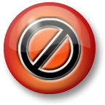
Naloxone is only used for opiate overdose
Remember, the following common street drugs are not opioids/opiates and therefore not addressed by this portion of the protocol: cocaine, LSD, ecstasy(Molly), sedatives/tranquilizers, and marijuana.
Notes:
Remember, Narcan is specific to opioid and opiate overdoses!

Slide 7
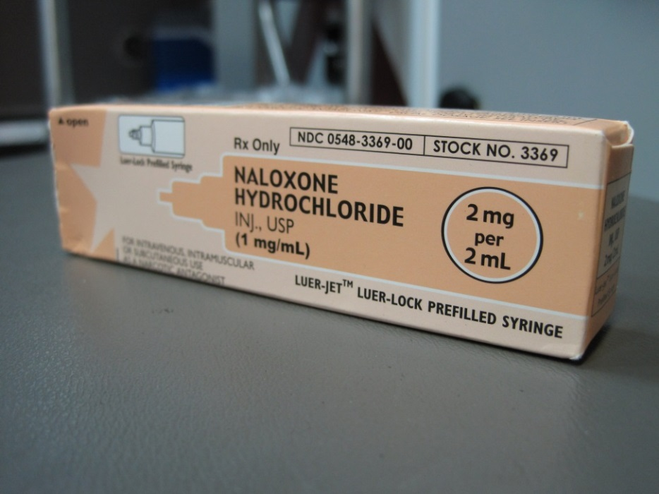
Intranasal Naloxone
Naloxone (Narcan) is an antidote that can reverse overdose of opioids/opiates.
Naloxone is NOT effective against respiratory depression due to non-opioid drugs (or other causes).
Notes:
Naloxone can reverse central nervous system and respiratory depression due to an overdose of opioids opiates. It is not effective against respiratory depression due to non-opioid drugs. Thus, it is important to recognize the signs and symptoms of an opioid or opiate overdose and use naloxone appropriately.

Slide 8
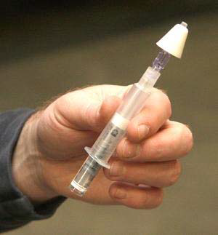
Why Intranasal Naloxone?
Very low risk of exposure to blood (no needle)
Can be administered quickly and with little training
Onset of action is quick
Very effective when used
Notes:
There are many positive reasons for bystanders to administer intranasal naloxone. It minimizes the risk for blood borne pathogen exposure. It can be rapidly administered and naloxone has a 3-5 minute onset with peak effect in 12-20 minutes.

Slide 9
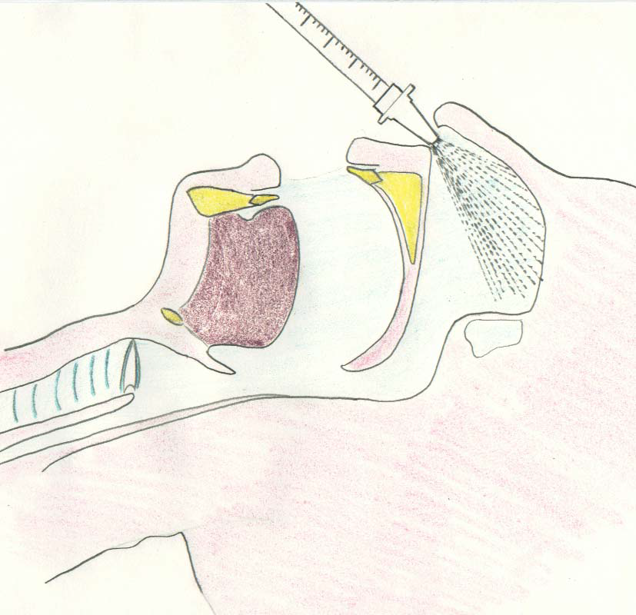
Why Intranasal Naloxone?
Works quickly since the nose has a large area for absorbing drugs directly into the blood stream.
Notes:
Intranasal administration allows bystanders to administer naloxone almost as quickly as the intravenous route. The nasal mucosa is highly vascularized and absorbs drugs directly into the blood stream.

Slide 10
What does Opioid/Opiate overdose look like?
The person is:
  Not responsive when shaken
  Possibly not breathing well, or not breathing at all
  Possibly breathing less than 6 breaths per minute
  Possibly having a bluish color of the skin, nails or lips
  Small pupils
Notes:
A toxidrome is a group of signs and symptoms constituting the basis for a diagnosis of a poisoning. Remember, there are many signs and symptoms of an opioid or opiate overdose, but intranasal naloxone is indicated for a patient with respiratory arrest or hypoventilation.

Slide 11
When to use intranasal Naloxone?
If a person is not responding to you.
If bystanders report drug use and the person is not responding to you.
If there are drug bottles, or signs of injection of drugs on the skin (“track marks”) and the person is not responding to you.
Notes:
What are the indications of an opioid or opiate overdose? 1. Respiratory arrest or hypoventilation with evidence of use by bystander report, drug paraphernalia, prescription bottles, or track marks – and/or 2. recognition of the opiate/opioid toxidrome.

Slide 12
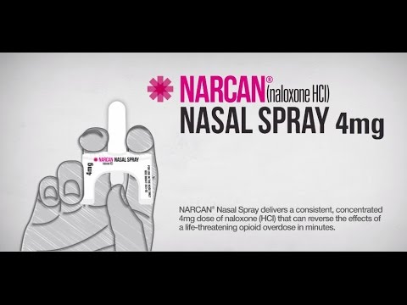

Slide 13
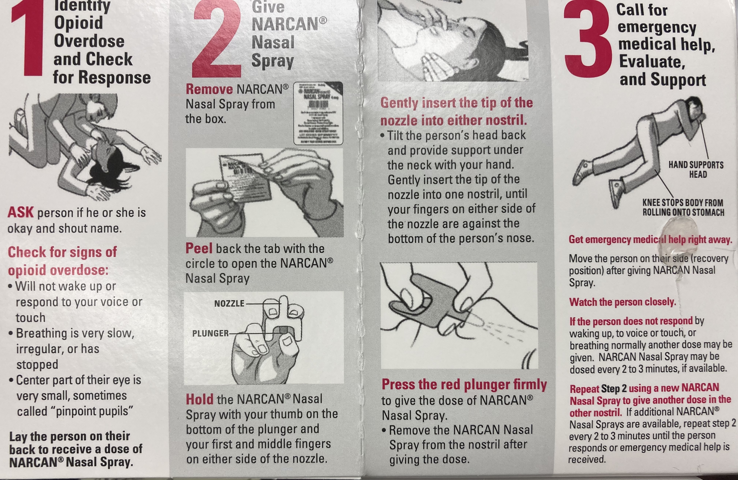
Narcan Video

Slide 14
Notes:
What are the indications of an opioid or opiate overdose? 1. Respiratory arrest or hypoventilation with evidence of use by bystander report, drug paraphernalia, prescription bottles, or track marks – and/or 2. recognition of the opiate/opioid toxidrome.

Slide 17
Notes:
What are the indications of an opioid or opiate overdose? 1. Respiratory arrest or hypoventilation with evidence of use by bystander report, drug paraphernalia, prescription bottles, or track marks – and/or 2. recognition of the opiate/opioid toxidrome.

